Slide 1
One Shot Instructions
© 2015 John Sefcovic

Slide 2
One Shot
A One Shot are instructions that makes the rung true for one program scan upon a transition of the rung by the input conditions preceding the one shot instruction on the rung.
Use the One Shot instructions to start events triggered by a pushbutton or limit switch that are only to be true (ON) once.
To control the one-shot pulse, a Memory Bit is entered, and depending on the instruction a pulsed Output Bit.
There are two types of one shot functions:
              One Shot Rising
              One Shot Falling

Slide 3
One Shot
One Shot Rising
The One Shot Rising will cause on the false-to-true transition of the Input to turn On the Output for one scan.
INPUT
OUTPUT
ONE
SCAN

Slide 4
One Shot
One Shot Falling
The One Shot Falling will cause on the true-to-false transition of the Input to turn On the Output for one scan.
INPUT
OUTPUT
ONE
SCAN

Slide 5




One Shot
Siemens One Shot instructions are:
Scan Operand For Positive Signal Edge input.
Scan Operand For Negative Signal Edge input.
Set Operand On Positive Signal Edge output.
Set Operand On Negative Signal Edge output.

Slide 6


One Shot
Siemens One Shot instructions are:
Scan RLO For Positive Signal Edge (P_TRIG) input.
Scan RLO For Negative Signal Edge (N_TRIG) input.

Slide 7


One Shot
Siemens One Shot instructions are:
Set Tag On Positive Signal Edge (R_TRIG).
Set Tag On Negative Signal Edge (F_TRIG).
Output

Slide 8
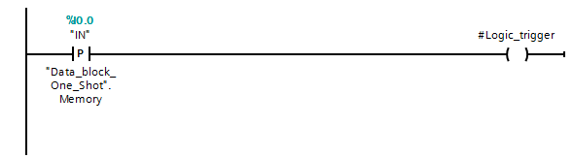

One Shot
# sign local tag
Scan Operand For Positive Signal Edge input instruction is used as an input, on a positive transition, to make the rung’s output true for one scan. The memory bit store the status edge occurrence.
The one shot rung output’s pulsed status is used as a condition on additional rungs for other control functions.
Input combined with oneshot

Slide 9


One Shot
Scan Operand For Negative Signal Edge input instruction is used as an input, on a negative transition, to make the rung’s output true for one scan. The memory bit store the status edge occurrence.
The one shot rung output’s pulsed status is used as a condition on additional rungs for other control functions.

Slide 10
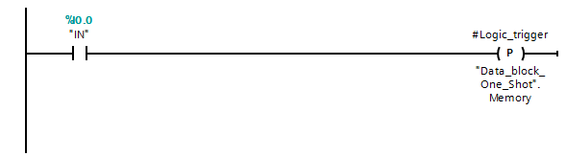

One Shot
Use this bit trigger something once , action once
Set Operand On Positive Signal Edge output instruction, on a positive transition, makes the rung’s output true for one scan. The memory bit store the status edge occurrence.
The one shot output’s pulsed status is used as a condition on additional rungs for other control functions.

Slide 11


One Shot
Set Operand On Negative Signal Edge output instruction, on a negative transition, makes the rung’s output true for one scan. The memory bit store the status edge occurrence.
The one shot output’s pulsed status is used as a condition on additional rungs for other control functions.

Slide 12
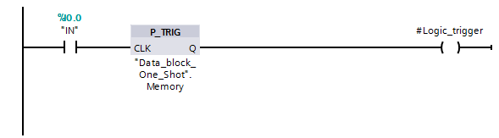
One Shot
Scan RLO For Positive Signal Edge (P_TRIG) instruction, on a positive transition, to make the instruction’s output true for one scan. The memory bit store the status edge occurrence.
The one shot rung output’s pulsed status is used as a condition on additional rungs for other control functions.

Slide 13

One Shot
Scan RLO For Negative Signal Edge (N_TRIG) instruction, on a negative transition, makes the instruction’s output true for one scan. The memory bit store the status edge occurrence.
The one shot rung output’s pulsed status is used as a condition on additional rungs for other control functions.

Slide 14
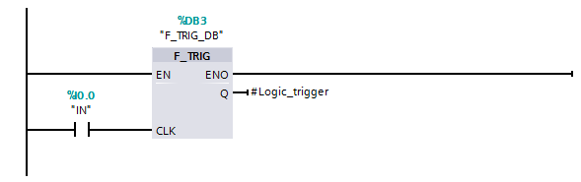
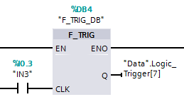
One Shot
enable like an on/off switch
Always true
Clock triggers when true one scan q
You can just assign the tag
The Enabled instruction, Set Tag On Positive Signal Edge (R_TRIG), on a negative transition, to make the instruction’s output true for one scan. A Memory Bit tracks the true-to-false transition of the rung, and the Output Bit is trigger ON for one scan on the transition.
A System Data Block is created for the EN, CLK, and Q bits. A protected System Function Block is also created.
The Output Bit’s pulsed status is used as a input condition on additional rungs for other control functions.

Slide 15
One Shot
An Enabled instruction Set Tag On Negative Signal Edge (F_TRIG), on a negative transition, to make the instruction’s output true for one scan. A Memory Bit tracks the true-to-false transition of the rung, and the Output Bit is trigger ON for one scan on the transition.
A System Data Block is created for the EN, CLK, and Q bits. A protected System Function Block is also created.
The Output Bit’s pulsed status is used as a input condition on additional rungs for other control functions.

Slide 16
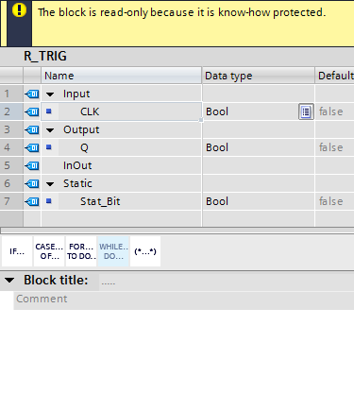
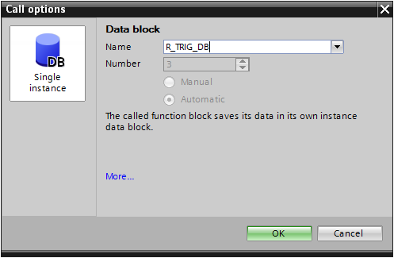
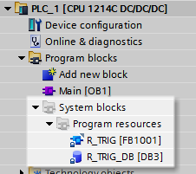
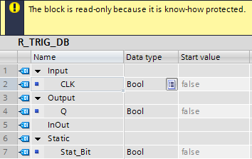
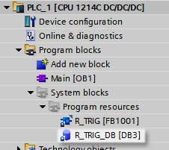
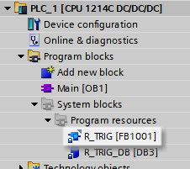
One Shot
The protected Data Block contains the instances from the Function Block.
The Set Tag On Positive Signal Edge (R_TRIG) and Set Tag On Negative Signal Edge (F_TRIG) create protected System Function Block and Data Block for each instruction in the program.
The protected Function Block creates the instances for the instruction’s Parameters.
The programming code is not visible in the protected Function Block.
A dialog for the one-shot instruction opens to create the blocks.

Slide 17
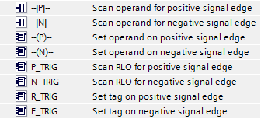
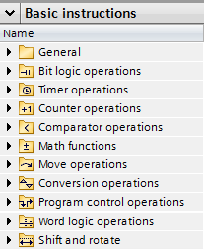
One Shot
The One Shot instructions are Basic Instruction in the Bit logic operations folder.

